Slide 1
CS 2001 Data Structures
Week 3
Linked List(Singly, Doubly, Circular)

Slide 2
Agenda
Limitation of Arrays.
What is a linked list? How is it structured? What is a node?
Vanilla implementation of a list(singly linked list
Insertions (at the head, at the tail, or with respect to an order), delete, search and other utility functions like reversing a linked list etc.

Slide 3
Limitations Of Arrays
Arrays are simple to understand and elements of an array are easily accessible
But arrays have some limitations.
  Arrays have a fixed dimension.
  Once the size of an array is decided it can not be increased or decreased during execution.
  Array elements are always stored in contiguous memory locations.
  Operations like insertion or deletion of the array are pretty tedious.
  To over come this limitations we use linked list.
Notes:
Why Linked List?
Arrays can be used to store linear data of similar types, but arrays have the following limitations.
1) The size of the arrays is fixed: So we must know the upper limit on the number of elements in advance. Also, generally, the allocated memory is equal to the upper limit irrespective of the usage.
2) Inserting a new element in an array of elements is expensive because the room has to be created for the new elements and to create room existing elements have to be shifted.
For example, in a system, if we maintain a sorted list of IDs in an array id[].
id[] = [1000, 1010, 1050, 2000, 2040].
And if we want to insert a new ID 1005, then to maintain the sorted order, we have to move all the elements after 1000 (excluding 1000).
Deletion is also expensive with arrays until unless some special techniques are used. For example, to delete 1010 in id[], everything after 1010 has to be moved.

Slide 4
Array Vs. Linked List
Array | Linked List
Fixed size: Resizing is expensive | Fixed size: Dynamic size
Insertions and Deletions are inefficient: Elements are usually shifted | Insertions and Deletions are efficient: No shifting
Random access i.e., efficient indexing | No random access Not suitable for operations requiring accessing elements by index such as sorting
No memory waste if the array is full or almost full; otherwise may result in much memory waste. | Since memory is allocated dynamically(acc. to our need) there is no waste of memory.
Sequential access is faster [Reason: Elements in contiguous memory locations] | Sequential access is slow [Reason: Elements not in contiguous memory locations]

Slide 5
Vectors VS Linked list
Vectors | Linkedlist
It has contiguous memory. | While it has non-contiguous memory.
Vector may have a default size. | List does not have default size.
In vector, each element only requires the space for itself only. | In list, each element requires extra space for the node which holds the element, including pointers to the next and previous elements in the list.
Insertion at the end requires constant time but insertion elsewhere is costly. | Insertion is cheap no matter where in the list it occurs.
Deletion at the end of the vector needs constant time but for the rest it is O(n). | Deletion is cheap no matter where in the list it occurs.
Random access of elements is possible. | Random access of elements is not possible.

Slide 6
Introduction:
A data structure is a logical representation of data and operation that can be performed on the data.
  Linear data structure
  Non linear data structure
  Linear data structure is an order of data elements. They are arrays, stacks, queues, and linked lists.

Slide 7
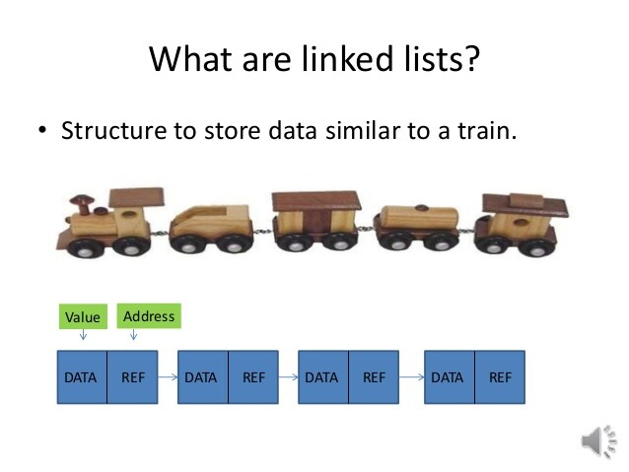
Basic idea of Linked list

Slide 8

Linked list
Linked list is a linear data structure. It contains nodes. Each node contains two parts,
i.e. DATA part and LINK part.
  The data contains elements and
  Link contains address of another node.

Slide 9
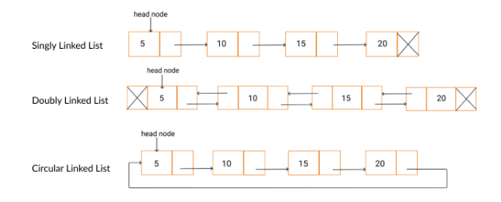
Types Of Linked Lists
Singly linked list
Doubly linked list
Circular linked list
  Circular singly linked list
  Circular doubly linked list

Slide 10
Singly linked list
A singly linked list is one in which all nodes are linked together in some sequential manner.
Operations on Single Linked List
The following operations are performed on a Single Linked List
    Traversal: accesses each element of the linked list
    Insertion: adds a new element to the linked list
    Deletion: removes the existing elements
    Search : Finds a node in the list
    Sort: Sorts the nodes of the linked list
    Reverse: Reverses the list
    etc.

Slide 11
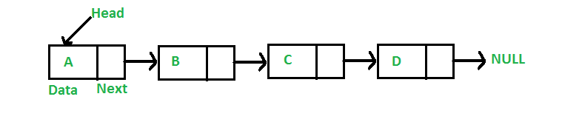
Representation Of Linked List
A linked list is represented by a pointer to the first node of the linked list.
The first node is called the head. If the linked list is empty, then the value of the head is NULL.
Each node in a list consists of at least two parts:
  Data
  Pointer (Or Reference) to the next node

Slide 12


Representation Of Linked List
In C, we can represent a node using structures. Below is an example of a linked list node with integer data.
In Java or C# or C++, LinkedList can be represented as a class and a Node as a separate class. The LinkedList class contains a reference of Node class type.

Slide 13
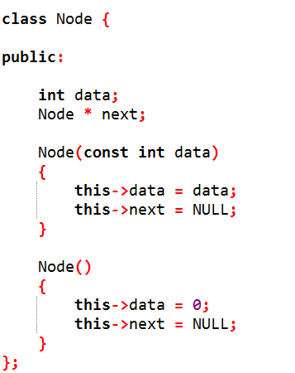
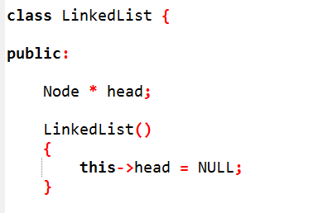
First Simple Linked
List in C++

Slide 14
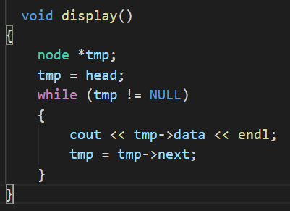
Traverse:
Display()
temp = head
while (temp != null) {
// print content
update temp.
}

Slide 15
Insertion
Insert at beginning
Insert at end
Insert at any position

Slide 16
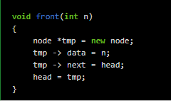
Insert at beginning

Slide 17
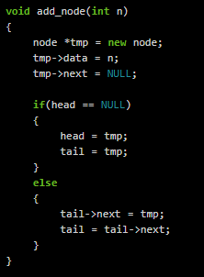
Add_node (Insert at end)
Insert in an empty LL and Insert at end

Slide 18
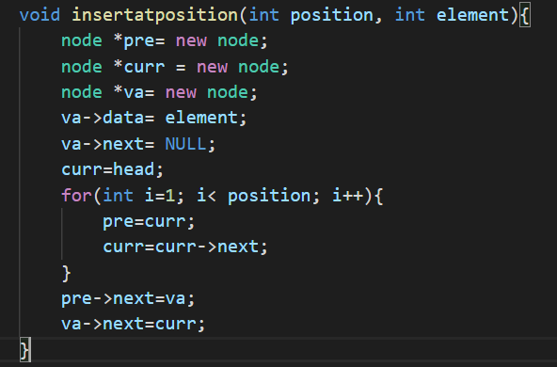
Insert at any position

Slide 19
Deletion
Delete from beginning/start/head/at front
Delete from end
Delete at any position

Slide 20
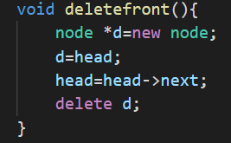
Delete at front

Slide 21
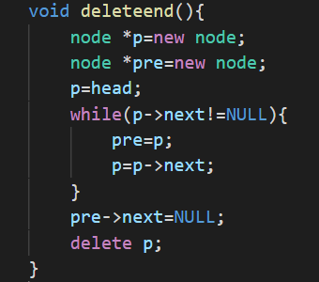
Delete from end

Slide 22
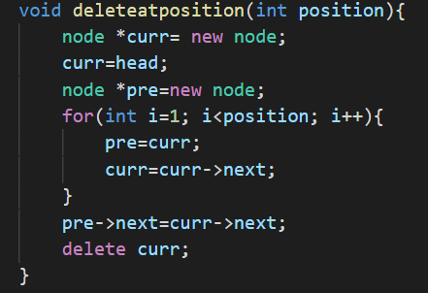
Delete at any position

Slide 23
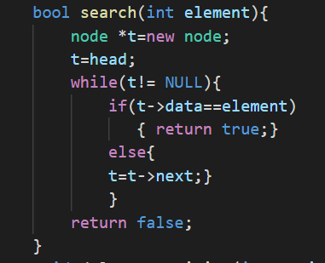
Search

Slide 24
Sort
Node temp=head, index
If head is null,
  return.
Else, run a loop till the last node (i.e. NULL).
  Index=temp.next
  Check if the data of the temp is greater than the index. If it is greater, swap temp and index.

Slide 25
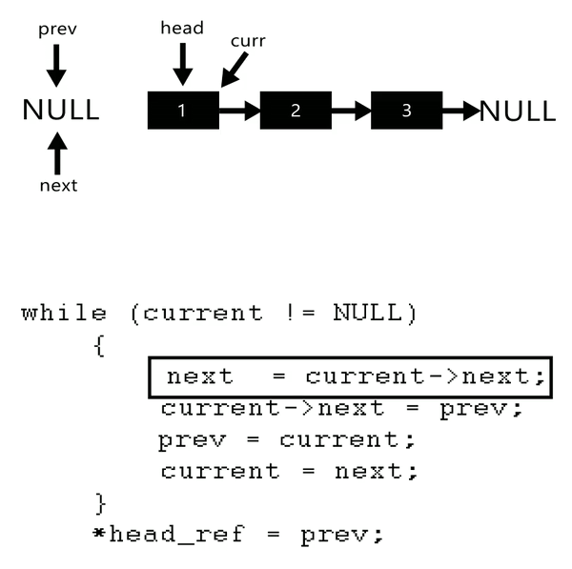
Reverse

Slide 26
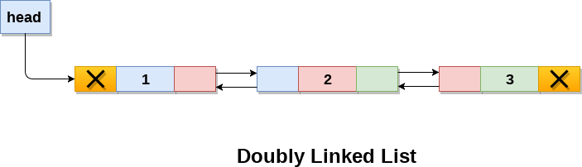
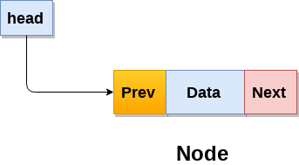
Doubly linked list
A type of linked list in which a node contains a pointer to the previous as well as the next node in the sequence.
Adv: Given a node, it’s easy to visit its predecessor, convenient to traverse list backwards.

Slide 27
Fundamental functions and Utility functions
The following operations are performed on a Doubly Linked List
    Traversal: accesses each element of the linked list
    Insertion: adds a new element to the linked list
    Deletion: removes the existing elements
    Search : Finds a node in the list
    Sort: Sorts the nodes of the linked list
    Reverse: Reverses the list
    etc.

Slide 28
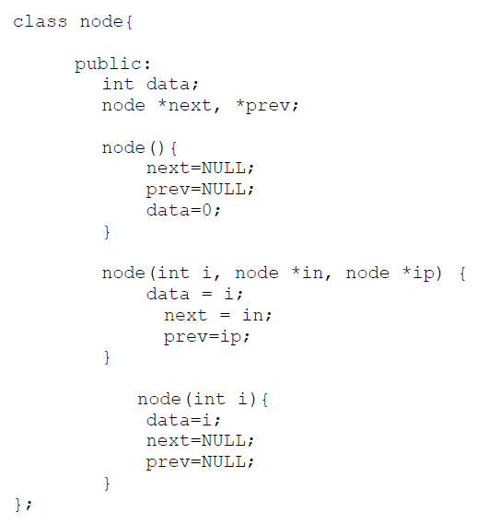
First Simple Linked
List in C++

Slide 29
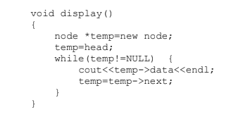
Traverse:

Slide 30
Traverse Backwards
Write yourself??

Slide 31
Insertion
Insert at beginning
Insert at end
Insert at any position

Slide 32
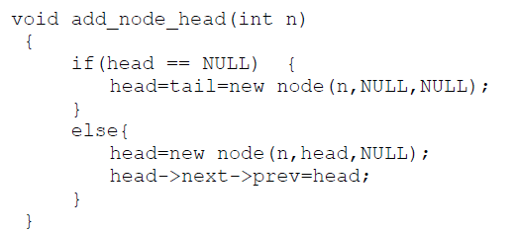
Insert at beginning

Slide 33
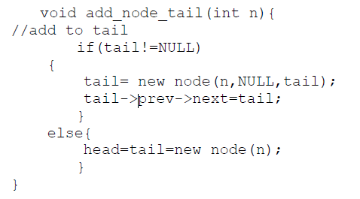
Add_node (Insert at end)
Insert in an empty LL and Insert at end

Slide 34
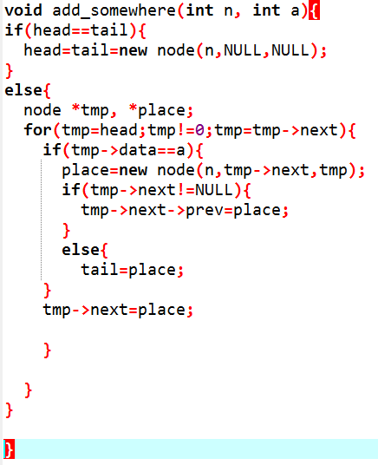
Insert at any position

Slide 35
Deletion
Delete from beginning/start/head/at front
Delete from end
Delete at any position

Slide 36
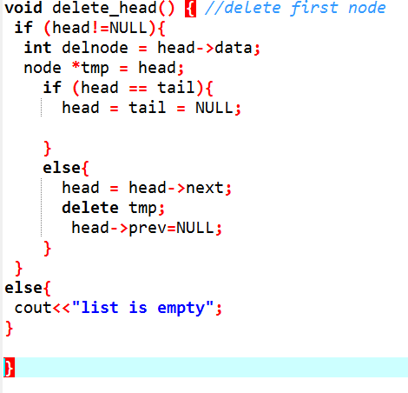
Delete at front

Slide 37
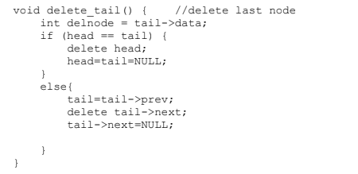
Delete from end

Slide 38
Delete at any position
Do yourself?

Slide 39

Search

Slide 40
Sort
Write yourself?

Slide 41
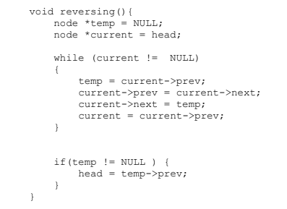
Reverse

Slide 42
Applications discussion
Linked lists are used in variety of applications in computer Science.
It is used very often into operating system concepts and in places where we cannot get a large chunk of memory or we have to use dynamic memory.
  For ex, if you have data worth 1.5 GB and you cannot get that much contiguous space in your computer, but you can get at most 0.5 GB of contiguous memory chunk, you can divide the data into 3 parts and then store the location of first chunk somewhere, store the location of second chunk in first chunk, location of third chunk in second chunk and so on.
  In this way , you can read this large chunk of data without having to bother to store it as a large chunk
Undo functionality in photo editors, text editors. (a linked list of different states)
The cache in browser. (allows you to hit back and fwd links URL’s through linked list)
Image viewer! (next and previous button. the next and previous images are linked there

Slide 43
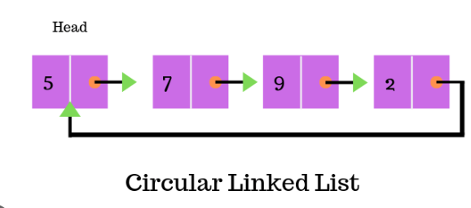
Circular Linked List

Slide 44
Fundamental functions and Utility functions
The following operations are performed on a Circular Linked List
    Traversal: accesses each element of the linked list
    Insertion: adds a new element to the linked list
    Deletion: removes the existing elements
    Search : Finds a node in the list
    Sort: Sorts the nodes of the linked list
    Reverse: Reverses the list
    etc.
Circular linked list can have two variations, Singly circular linked list and Doubly circular linked list.

